Slide 2




Organization
Notes:
Networking - a wide support among stakeholders in line with the swedish model

Slide 3
Planning of the congress
Content
Opening and closing ceremonies
Scientific programme & in-congress excursions
Speakers
Abstracts & proceedings process

Slide 4
Planning of the congress
Social
Net-working opportunities
Meals & events
Social/touristic excursions and visits
Spouse’s programme

Slide 5
Planning of the congress
Practical
Process plan
Financial plan & budget
Sponsorship and funding
Communications & marketing plan
Materials produktion
Venue & technical solutions
Exhibition plan

Slide 6
Planning of the congress
Practical
Delegate’s administration
Staff & support
Health & Security
Sustainability
Logistics

Slide 7
The Swedish National IUFRO Group
SLU (8)
Holmen Skog
Luleå University of Technology
The Swedish research council,
FORMAS
The Forestry Research Institute, SkogForsk
The Swedish Forest Agency
Linnaeus University, Växjö
The Royal Swedish Academy of Agriculture and Forestry
Notes:
A national IUFRO Member working group, built upon the IUFRO Member Organizations
New members: e.g. Umeå and Gothenburg univ

Slide 8

Our PCO:

Slide 9
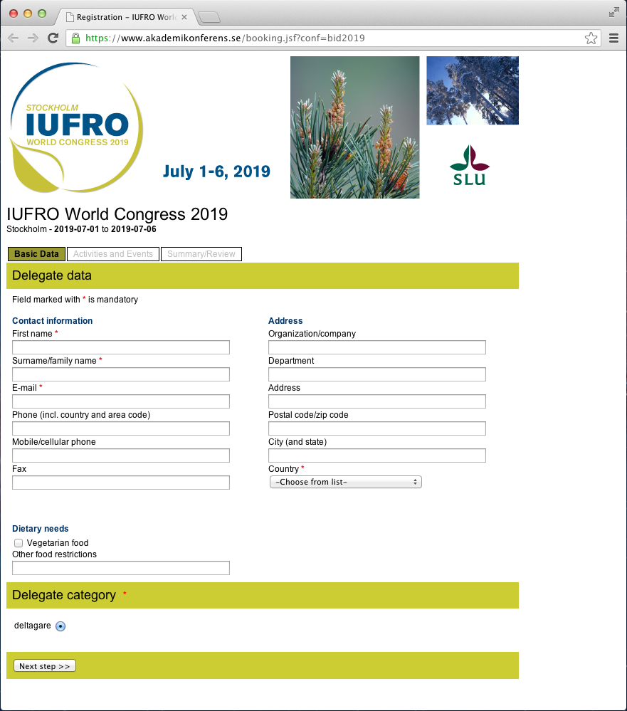

Slide 10
Congress Organizing Committee
Chair: Björn Hånell, SLU
Secretary: Fredrik Ingemarson, SIFI
The Swedish National IUFRO Group: Daniela Kleinschmit, SLU
Venue and PCO: Birgitta Naumburg, KSLA
Notes:
The Secretariat for International Forestry Issues (SIFI) is coordinating the application process in collaboration with the
Swedish University of Agricultural Sciences (SLU)
and the City of Stockholm.

Slide 11
Congress Organizing Committee
In-Congress tours: Fredrik Staland, SkogForsk
Göran Bergqvist, Swedish Association for Hunting and Wildlife Management
Peter Westman, Federation of Swedish Forest Owners
Post tours: Björn Merkell, Swedish Forest Agency
Mårten Larsson, Swedish Federation od Forest Industries
Marianne Eriksson, Federation of Swedish Forest Owners
Sponsorships: Marie Kofod-Hansen and Gunilla Åkerlund-Öberg
Notes:
The Secretariat for International Forestry Issues (SIFI) is coordinating the application process in collaboration with the
Swedish University of Agricultural Sciences (SLU)
and the City of Stockholm.

Slide 12
Support
Ministry for Rural Affairs
The City of Stockholm
The Royal Swedish Academy of Agricultur and Forestry
The Forest Research Institute of Sweden
The Swedish National Group of IUFRO Members
Linnæus University
The Swedish Forest Industries Federation
WWF Sweden
Swedish Association for Hunting and Wildlife
The Federation of Swedish Family Forest Owners
Vi Agroforestry
Sveaskog
Stora Enso Skog
IKEA of Sweden
Stockholm Visitors Board
Scandinavian Airlines System, SAS
Notes:
A national IUFRO Member working group, built upon the IUFRO Member Organizations
New members: e.g. Umeå and Gothenburg univ

Slide 13
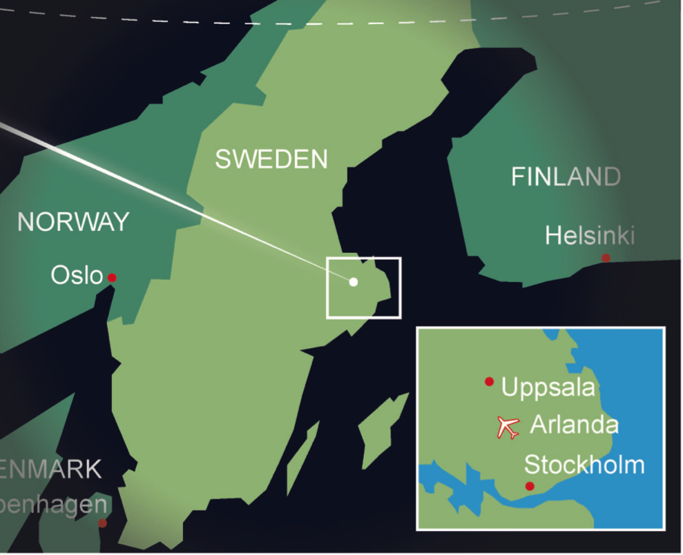
Professional Excursions
Post congress excursions
In congress excursion

Slide 14
Post congress excursions
Notes:
Sid 16 i biddet

Slide 15
Post Congress tour
”From coast to coast – Northern Family forestry”

Slide 16
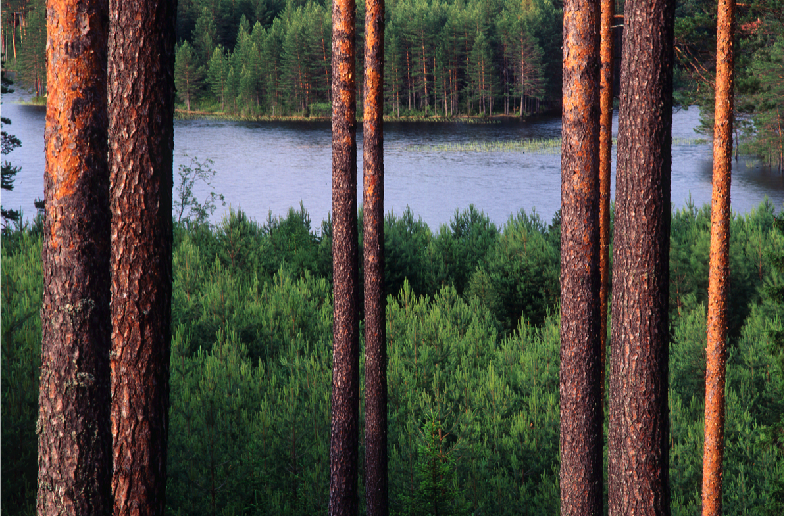

Slide 17
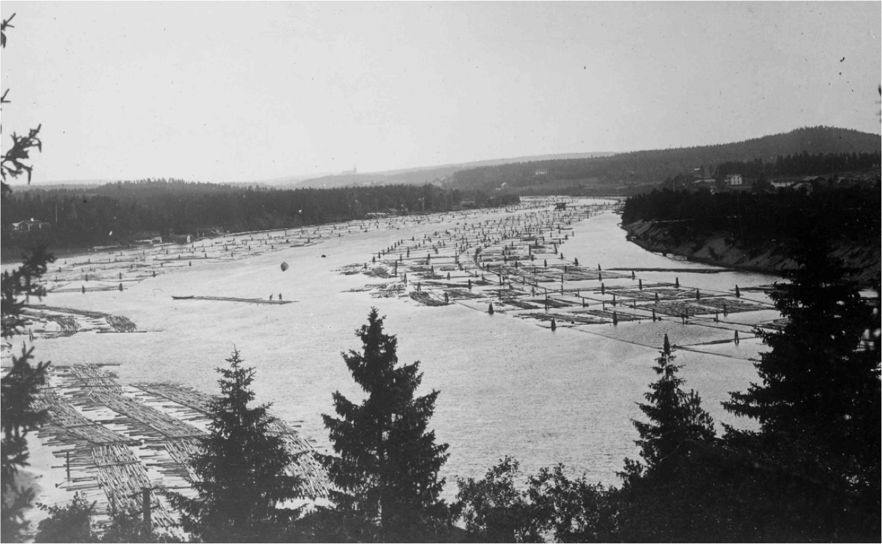

Slide 18
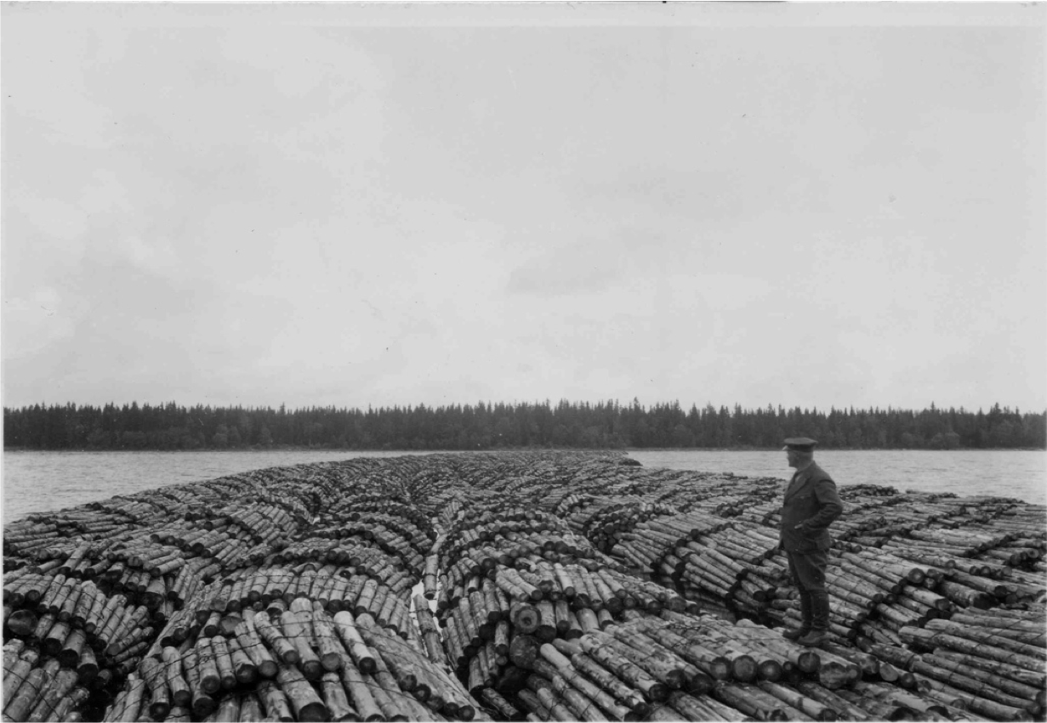

Slide 19
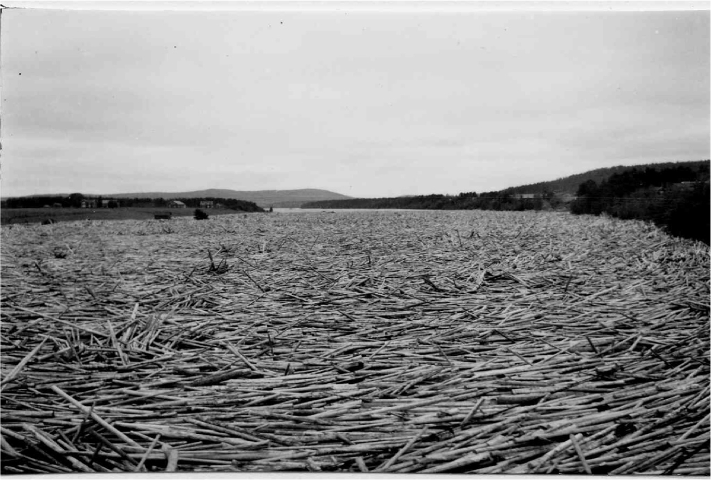

Slide 20
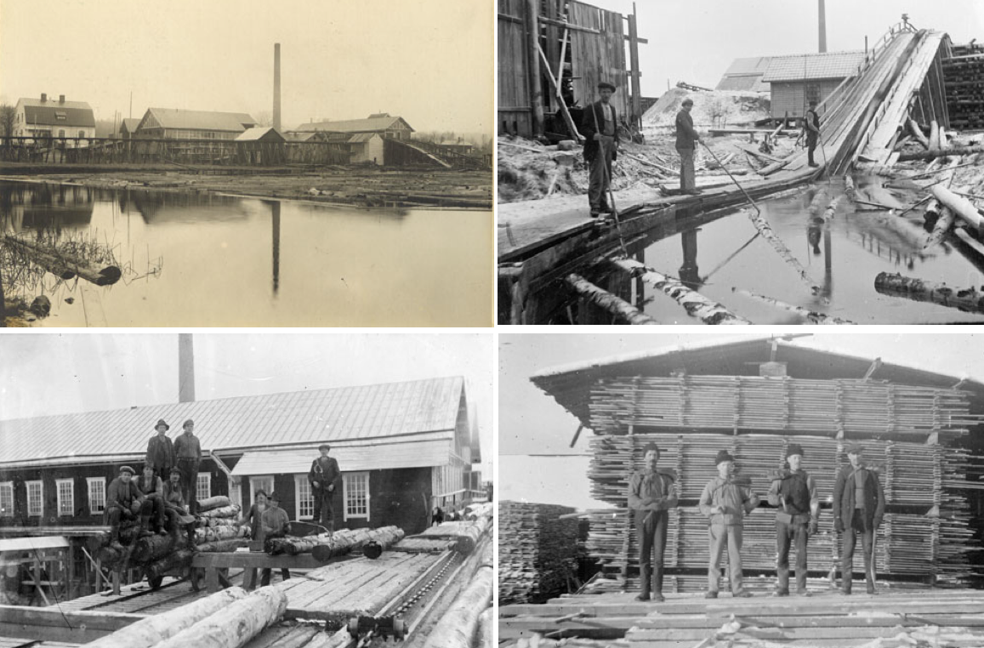

Slide 21
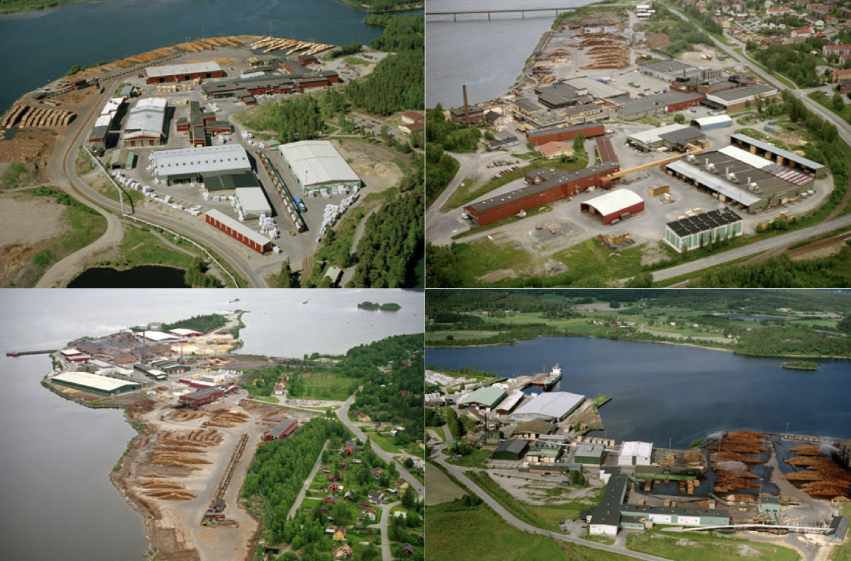

Slide 22
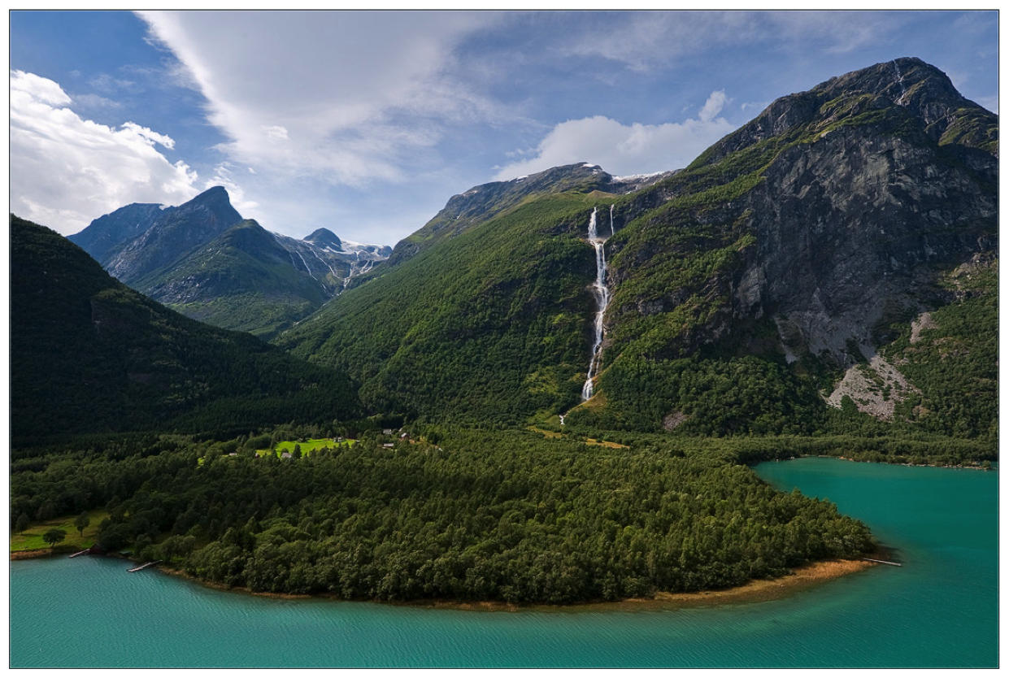

Slide 23
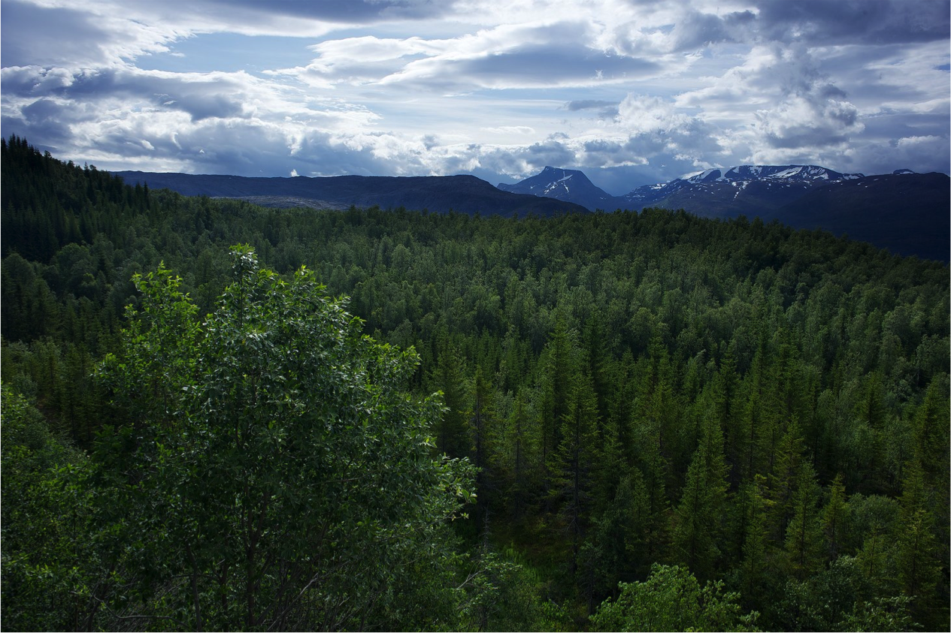

Slide 24
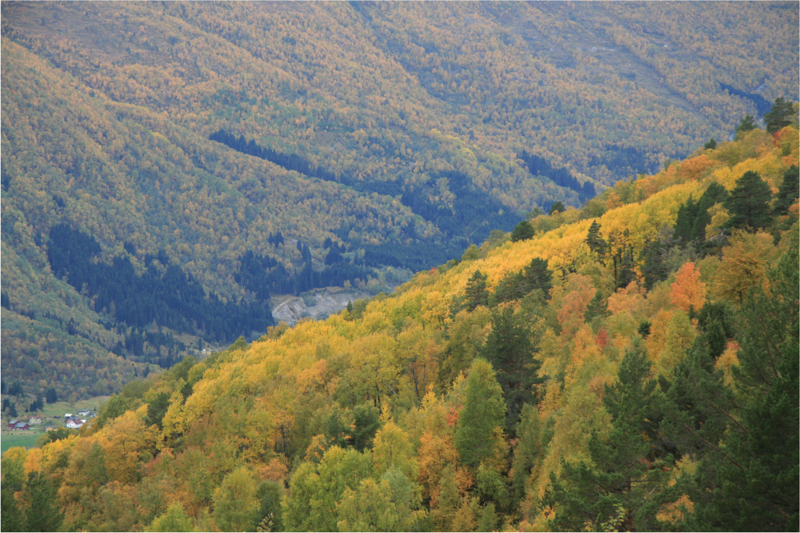

Slide 25
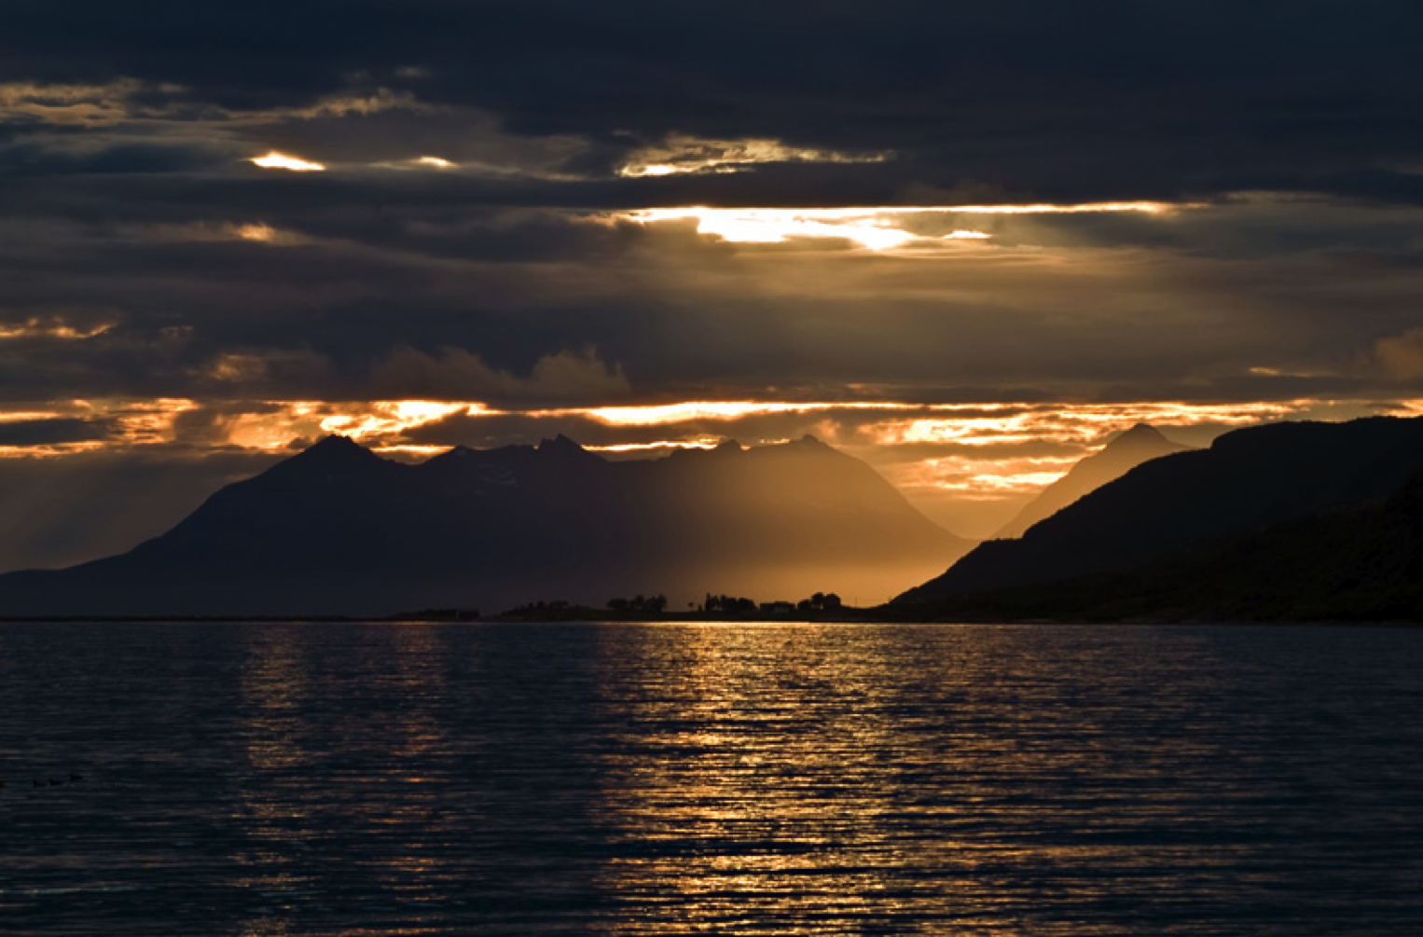

Slide 26
Post Congress tour
”Boreal peatlands and carbon balance in the North”

Slide 27
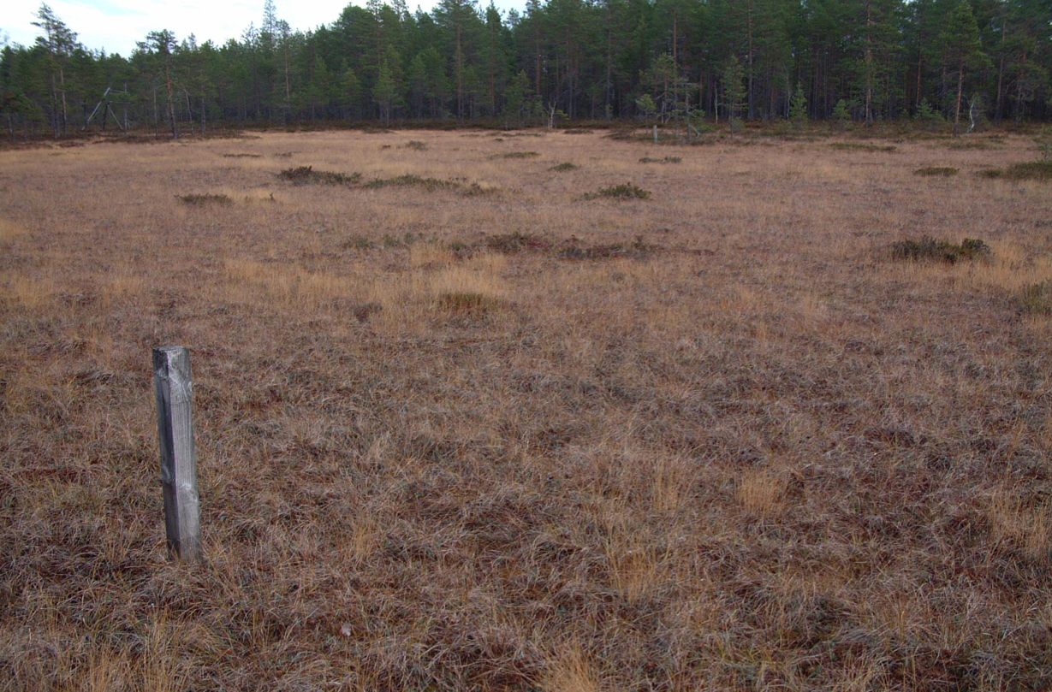

Slide 28
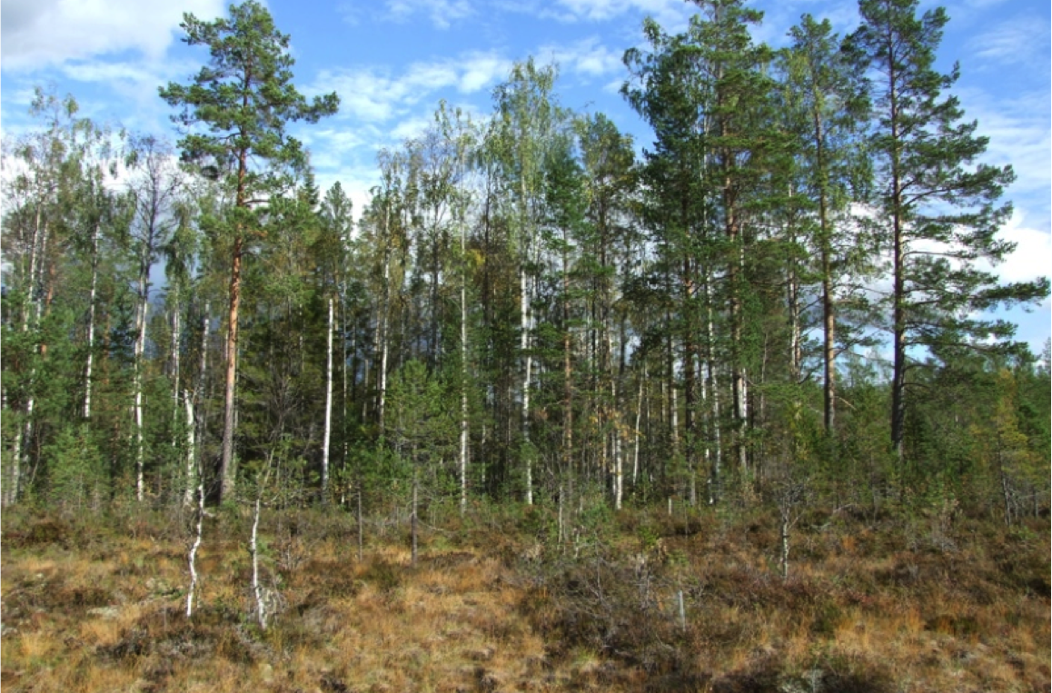

Slide 29
Post Congress tour
”From the forest to IKEA”

Slide 30
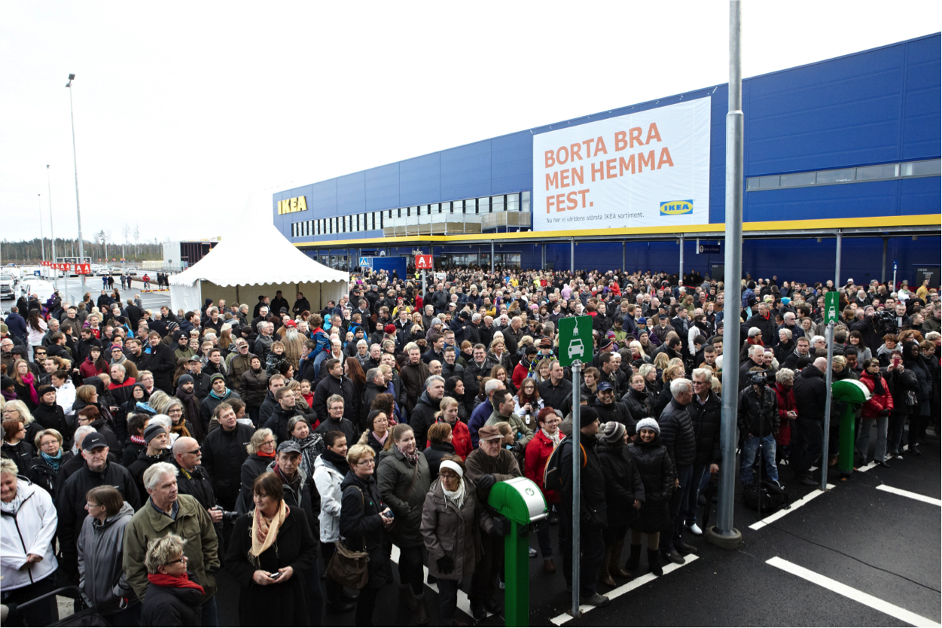

Slide 31
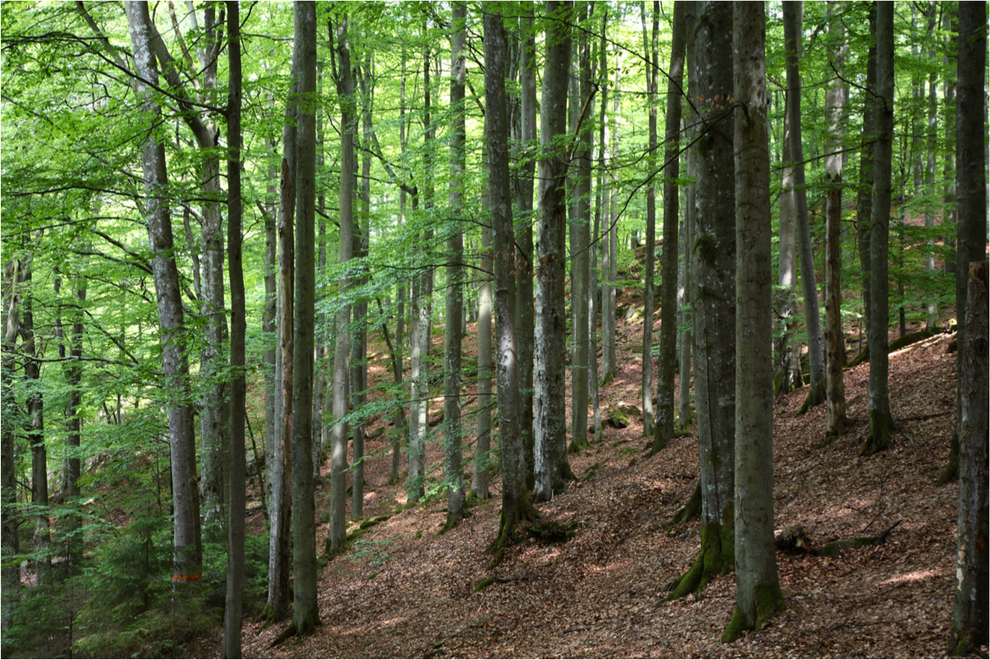

Slide 32
Post Congress tour
”Forestry on an island in the Atlantic Ocean”

Slide 33
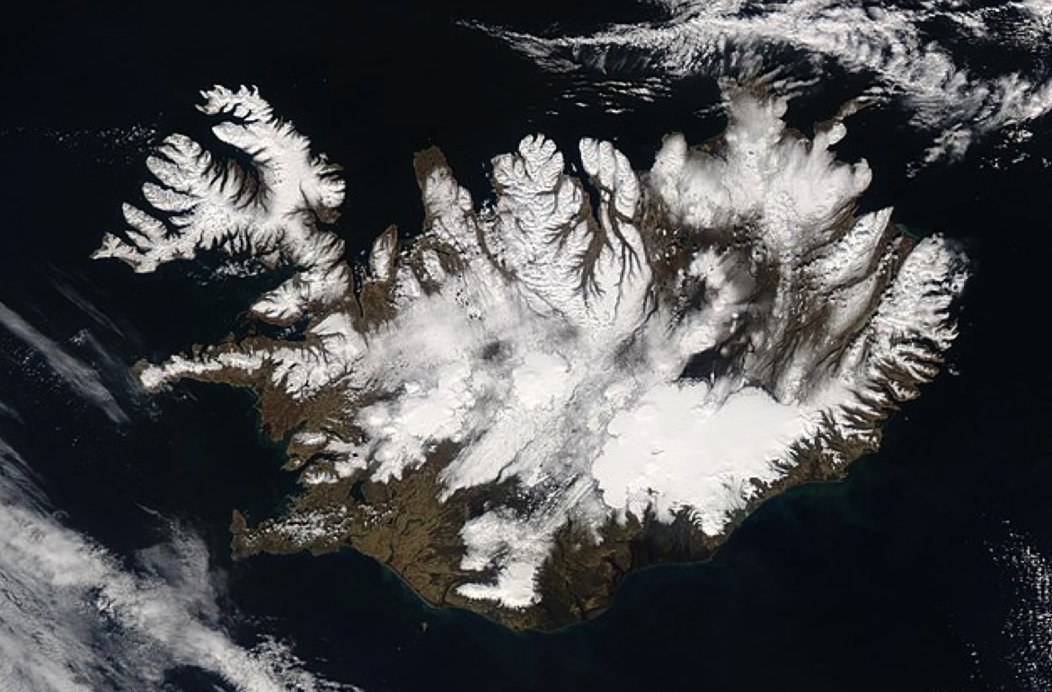

Slide 34
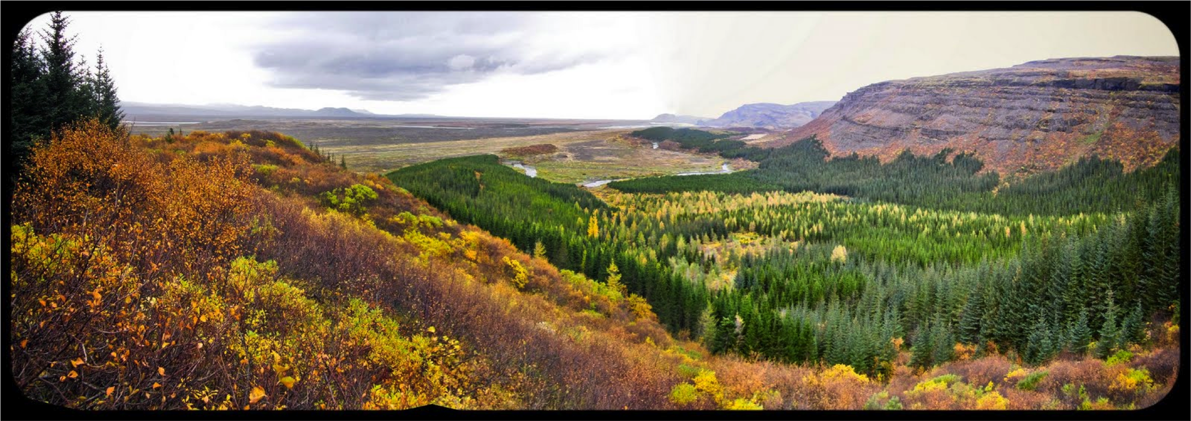

Slide 35
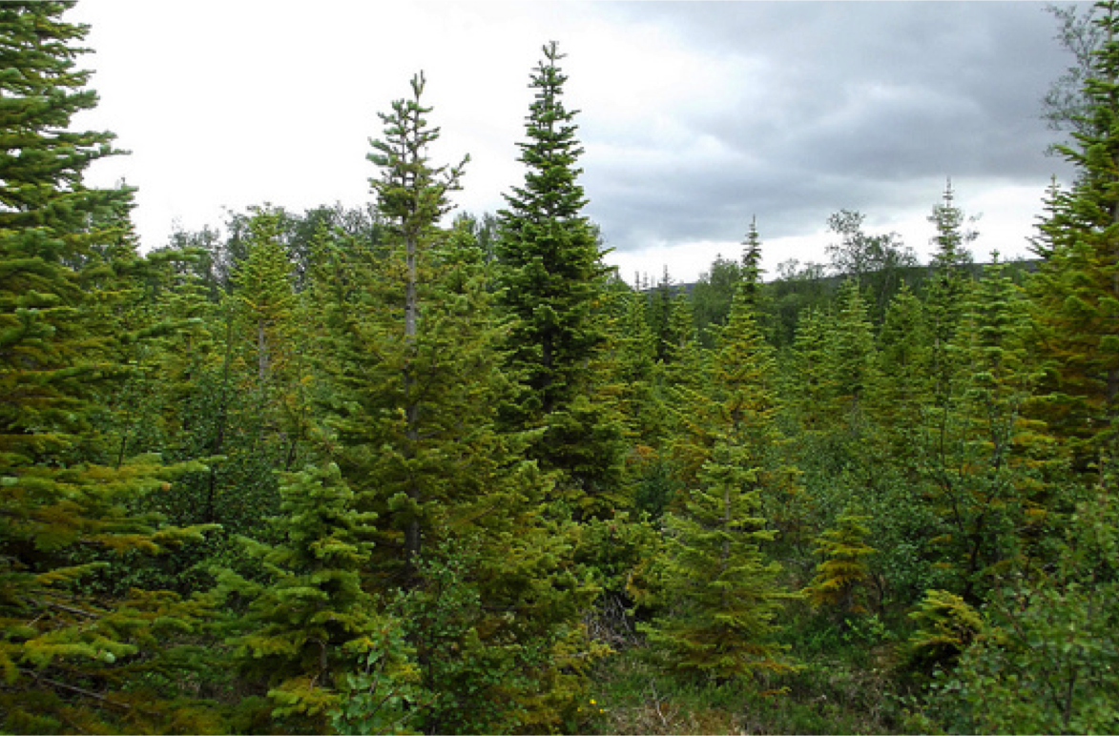

Slide 36
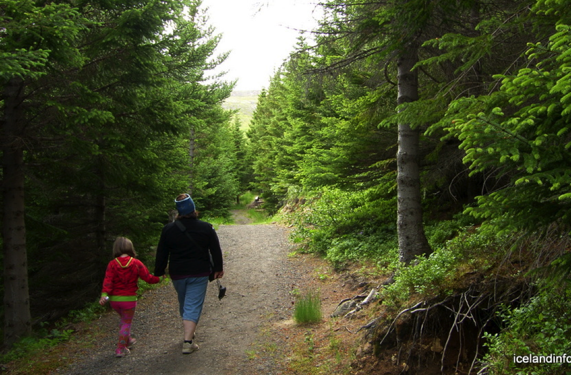

Slide 37
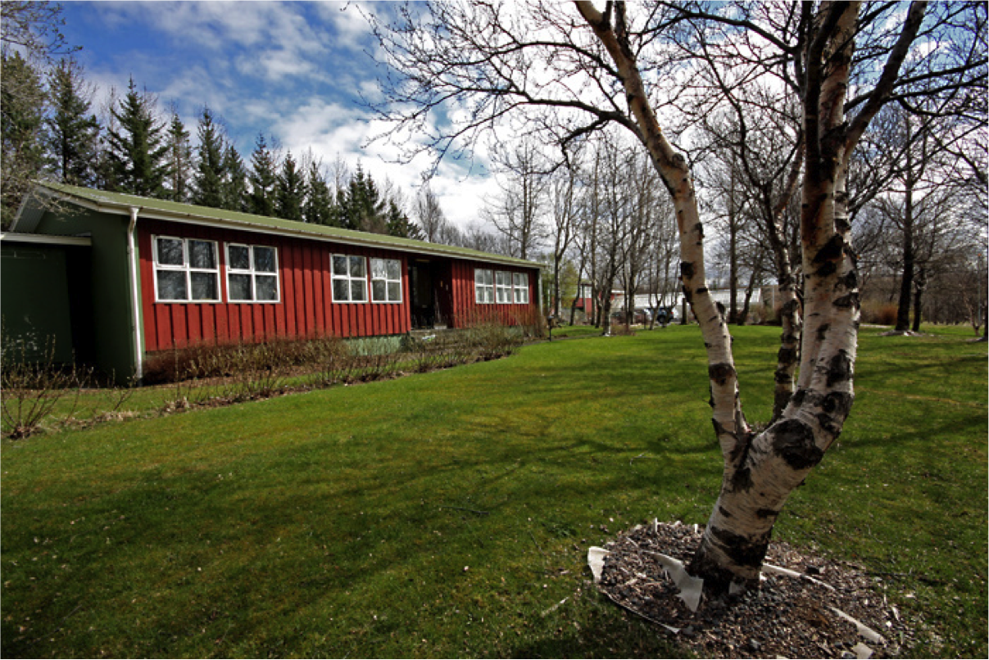

Slide 38
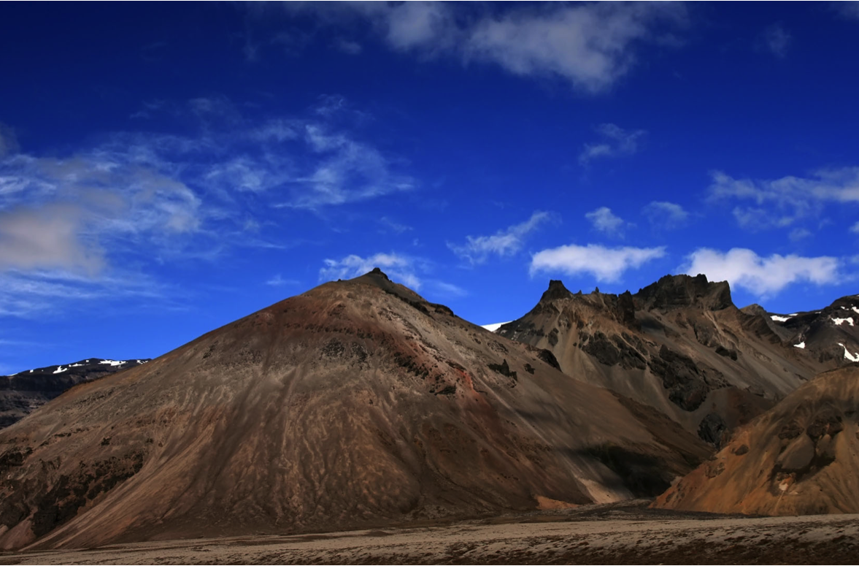

Slide 39
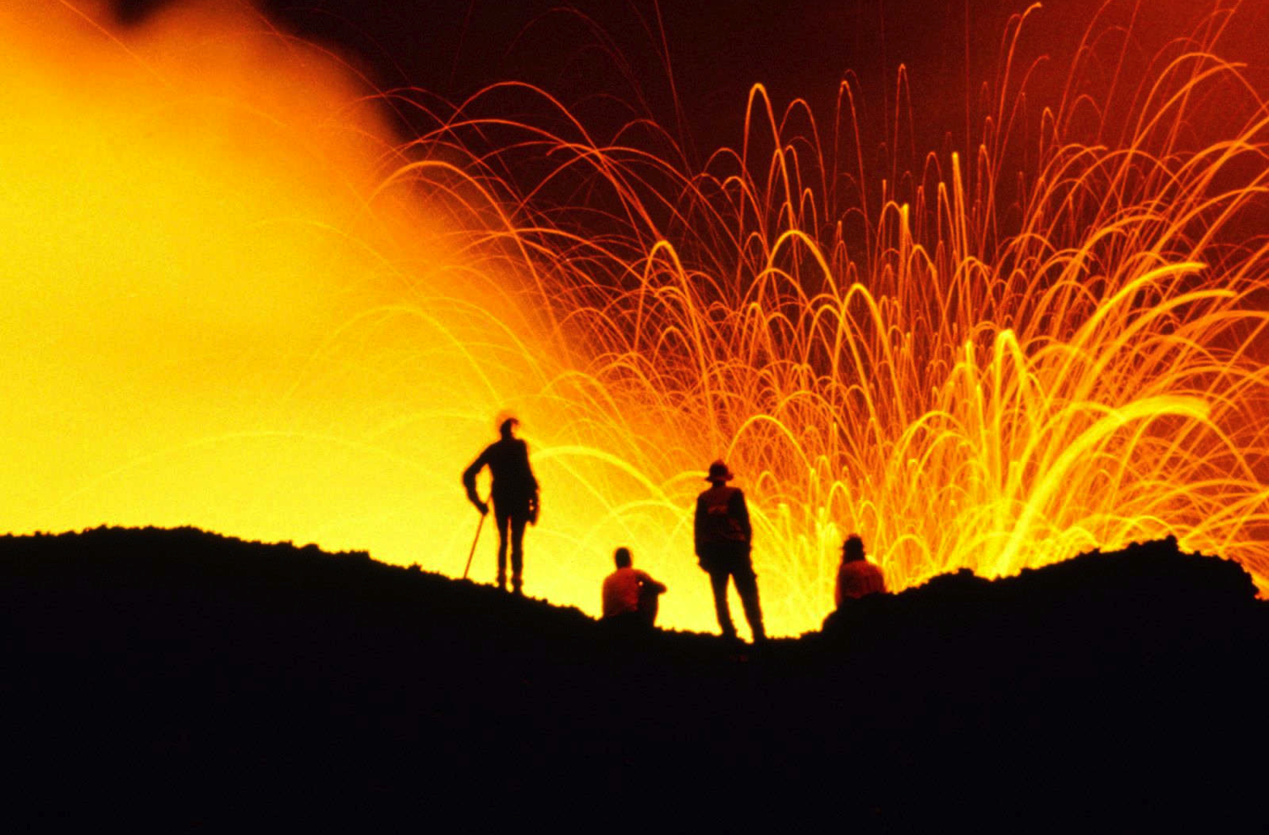

Slide 41
In congress excursion

Slide 42
Filmklipp - Bussintroduktion
Det har strulat med inbäddningen
av filmklippet i presentationen. Vi får fundera på en lösning.

Slide 43
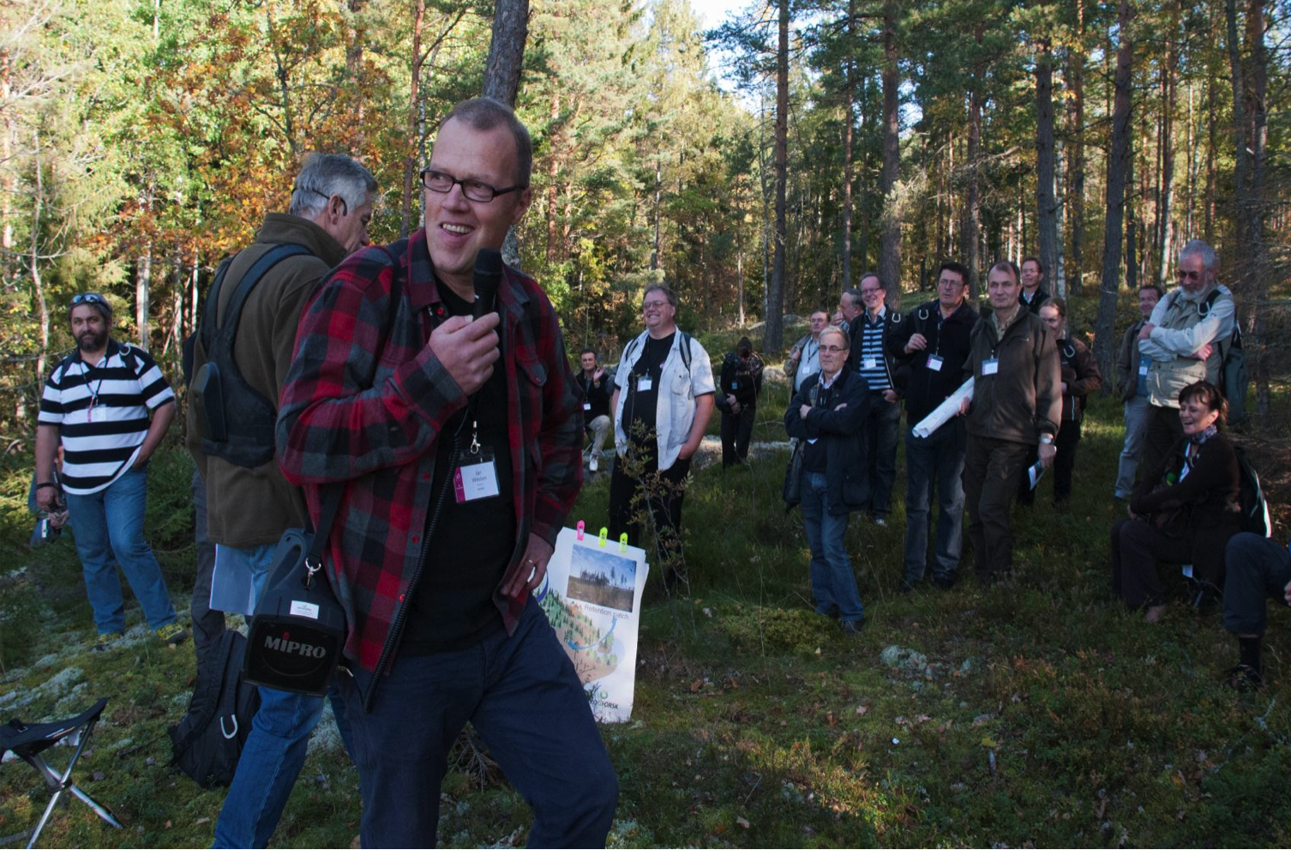
Excursion traditions & Wide support

Slide 44
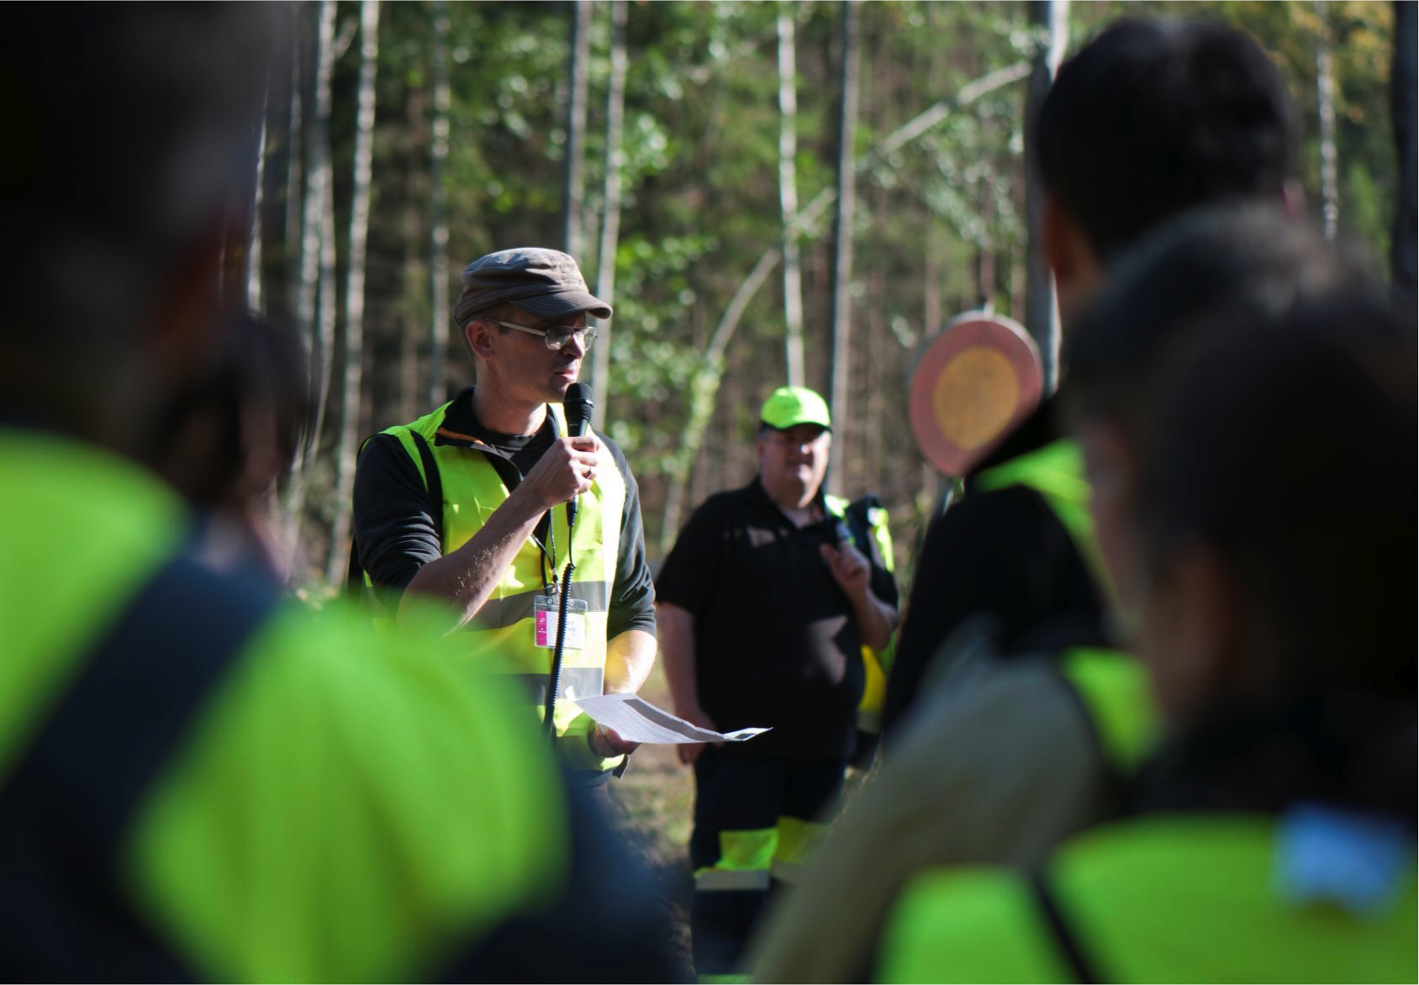
Skilled excursion leaders & support

Slide 45
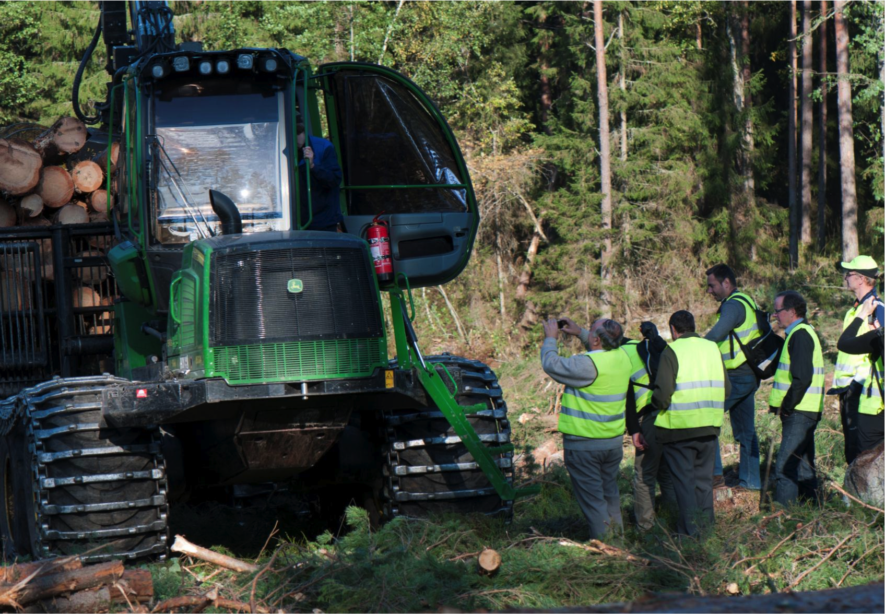
Meet the craftsmen

Slide 46
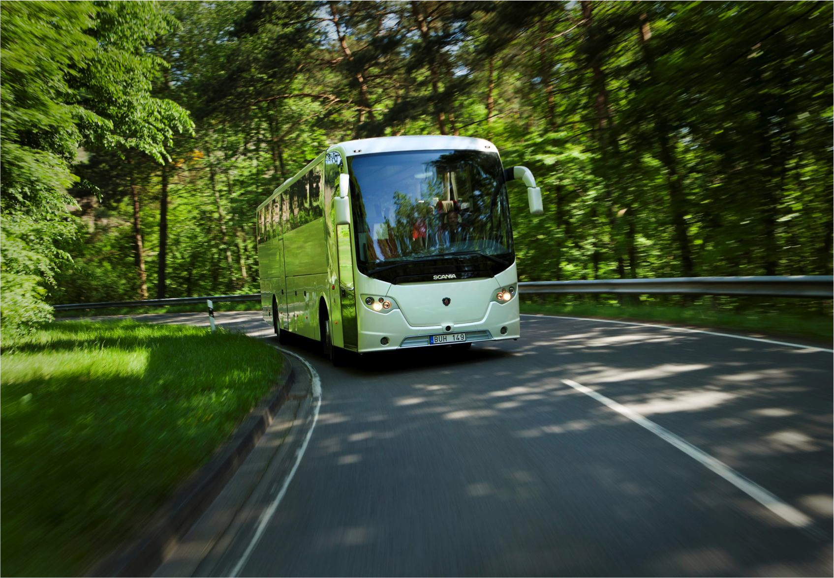
Let’s use the bus!

Slide 47
In-congress excursions
Hunting and wildlife management – The swedish association for wildlife management
The Swedish tree breeding – Svenska skogsplantor
The digital chain – Holmen skog
Remote sensing into the future – The Swedish University of Agricultural Sciences
Small and medium-sized forest industries and the value chain – The Linnæus University
Sustainable family forestry – The Federation of forest owners

Slide 48
In-congress excursions
Forest health and damage – The Swedish University of Agricultural Sciences
Efficacy in environmental concern – Sveaskog
Soil and water protection – Skogforsk - The Forestry Research Institute of Sweden
Urban forests and potential conflicts – National Forest Agency
Historical wood-building and cultural traditions in Scandinavia – The Royal Swedish Academy of Agriculture and Forestry

Slide 50
The financial plan

Slide 51
The financial plan
Financing
Book-keeping
Follow-up
Accounts
Financial report
Decision
Set-up
Planning
On-site
Closure
Goals Analysis
Marketing plan
Delegate admin.
Hosting
Evaluation

Slide 52
Key elements of the budget
Well anchored among stakeholders
A strong host and PCO collaboration
Government fully support
Development countries collaboration
Well-established supporting institutions
Strong sponsors
Different scenarios for further discussions

Slide 53
Budget € - 2 000 delegates
INCOME |  | Scenario 1 | Scenario 2
Sponsors |  | 174 068 | 522 205
Contributions SAP |  | 123 008 | 203 080
Contributions research council |  | 110 243 | 290 114
Exhibition |  | 261 103 | 261 103
Delegate Fee |  | 1 030 086 | 515 043
Gala dinner Fee |  | 0 | 87 034
TOTAL INCOME |  | 1 698 509 | 1 878 579

Slide 54
Budget € - 2 000 delegates
EXPENDITURE
Venue Cost |  | 418 154 | 418 154
Excursion Day |  | 89 355 | 89 355
Technic and decoration |  | 118 250 | 118 250
PCO & staff |  | 77 704 | 77 704
Invited delegates |  | 37 657 | 31 251
Social activities |  | 246 597 | 246 597
Fee to IUFRO |  | 103 009 | 128 761
Fund for SPDC/SAP |  | 58 023 | 348 137
Other costs |  | 48 309 | 96 683
Variable cost per delegate |  | 469 405 | 213 176
TOTAL EXPENDITURE |  | 1 681 548 | 1 846 979
Surplus/deficit |  | 16 960 | 31 600

Slide 55
Budget € - 2 000 delegates
INCOME - 2 000 delegates |  | Scenario 1 | Scenario 2
Sponsors |  | 174 068 | 522 205
Contributions SAP |  | 123 008 | 203 080
Contributions research council |  | 110 243 | 290 114
Exhibition |  | 261 103 | 261 103
Delegate Fee |  | 1 030 086 | 515 043
Gala dinner Fee |  | 0 | 87 034
TOTAL INCOME |  | 1 698 509 | 1 878 579
EXPENDITURE - 2 000 delegates
Venue Cost |  | 418 154 | 418 154
Excursion Day |  | 89 355 | 89 355
Technic and decoration |  | 118 250 | 118 250
PCO & staff |  | 77 704 | 77 704
Invited delegates |  | 37 657 | 31 251
Social activities |  | 246 597 | 246 597
Fee to IUFRO |  | 103 009 | 128 761
Fund for SPDC/SAP |  | 58 023 | 348 137
Other costs |  | 48 309 | 96 683
Variable cost per delegate |  | 469 405 | 213 176
TOTAL EXPENDITURE |  | 1 681 548 | 1 846 979
Surplus/deficit |  | 16 960 | 31 600

Slide 56
Budget € - 3 000 delegates
INCOME |  | Scenario 1 | Scenario 2
Sponsorship |  | 174 068 | 522 205
Contribution SAP |  | 185 673 | 290 114
Contributions research councils |  | 110 243 | 290 114
Exhibition |  | 261 103 | 261 103
Delegate Fee |  | 1 558 029 | 779 014
Gala dinner Fee |  | 0 | 145 057
TOTAL INCOME |  | 2 289 116 | 2 287 607

Slide 57
Budget € - 3 000 delegates
EXPENDITURE
Venue Cost |  | 488 762 | 488 762
Excursion Day |  | 110 243 | 110 243
Technic and decoration |  | 123 473 | 123 473
PCO & staff |  | 93 324 | 93 324
Invited delegates |  | 37 657 | 31 251
Social activities |  | 362 643 | 362 643
Fee to IUFRO |  | 155 803 | 194 754
Fund for SPDC/SAP |  | 104 441 | 348 137
Other costs |  | 69 950 | 104 602
Variable cost per delegate |  | 701 496 | 317 153
TOTAL EXPENDITURE |  | 2 262 877 | 2 253 253
Surplus/deficit |  | 26 239 | 34 355

Slide 58
Budget € - 3 000 delegates
INCOME - 3 000 delegates |  | Scenario 1 | Scenario 2
Sponsorship |  | 174 068 | 522 205
Contribution SAP |  | 185 673 | 290 114
Contributions research councils |  | 110 243 | 290 114
Exhibition |  | 261 103 | 261 103
Delegate Fee |  | 1 558 029 | 779 014
Gala dinner Fee |  | 0 | 145 057
TOTAL INCOME |  | 2 289 116 | 2 287 607
EXPENDITURE - 3 000 delegates
Venue Cost |  | 488 762 | 488 762
Excursion Day |  | 110 243 | 110 243
Technic and decoration |  | 123 473 | 123 473
PCO & staff |  | 93 324 | 93 324
Invited delegates |  | 37 657 | 31 251
Social activities |  | 362 643 | 362 643
Fee to IUFRO |  | 155 803 | 194 754
Fund for SPDC/SAP |  | 104 441 | 348 137
Other costs |  | 69 950 | 104 602
Variable cost per delegate |  | 701 496 | 317 153
TOTAL EXPENDITURE |  | 2 262 877 | 2 253 253
Surplus/deficit |  | 26 239 | 34 355

Slide 59
Sponsor packages

Slide 60

Sponsor packages
Bronz packages
Exposure on printed matter, the website, and in the congress hall

Slide 61
Sponsor packages
Bronz packages
Exposure on printed matter, the website, and in the congress hall
Silver packages
A sponsorship program including access to a sponsor’s host

Slide 62
Sponsor packages
Bronz packages
Exposure on printed matter, the website, and in the congress hall
Silver packages
A sponsorship program including access to a sponsor’s host
Gold packages
A private meeting room,
a dedicated sponsor’s host and an front position in the exhibition

Slide 64
The support to IUFRO

Slide 65
To support IUFRO – Scenario 2
25 % of the registration fee for every delegate has been set aside to support IUFRO in the organizing of the scientific content.

Slide 66
To support IUFRO – Scenario 2
25 % of the registration fee for every delegate has been set aside to support IUFRO in the organizing of the scientific content.
350 000 € for a stronger scientist assistance programme for delegates from developing countries (SPDC/SAP).

Slide 67
To support IUFRO – Scenario 2
25 % of the registration fee for every delegate has been set aside to support IUFRO in the organizing of the scientific content.
350 000 € for a stronger scientist assistance programme for delegates from developing countries (SPDC/SAP).
Possible surplus is added to the fund for SPDC/SAP.

Slide 68
The cover of the expenses
Income | Scenario 1 (%) | Scenario 2 (%)
Sponsorship | 8% | 23%
Contribution SAP | 8% | 13%
Contributions research councils | 5% | 13%
Exhibition | 11% | 11%
Delegate Fee | 68% | 34%
Gala dinner Fee | 0% | 6%

